Slide 1

Bay Bluff, Cape Charles, Virginia
Elhai/El-hai Family Reunion 2009

Slide 2
General Information
3222 Butler’s Bluff Drive Cape Charles,
VA 23310 is the house’s address.
The reunion is from 4:00 PM July 25 to 10:00 AM August 1.

Slide 3
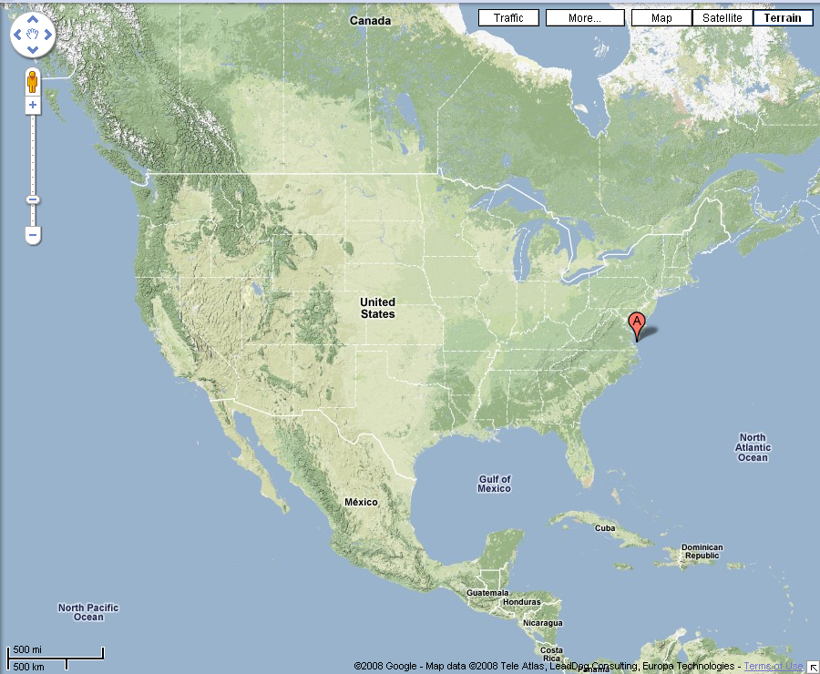
You are here…
…you would like to be here.

Slide 4
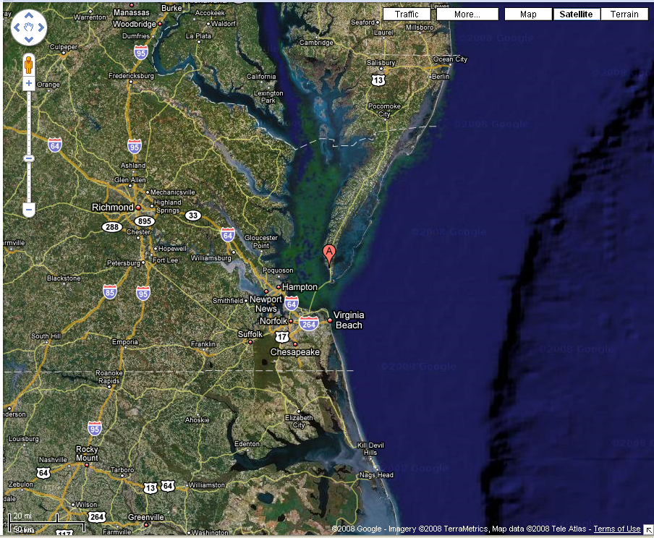

Slide 5
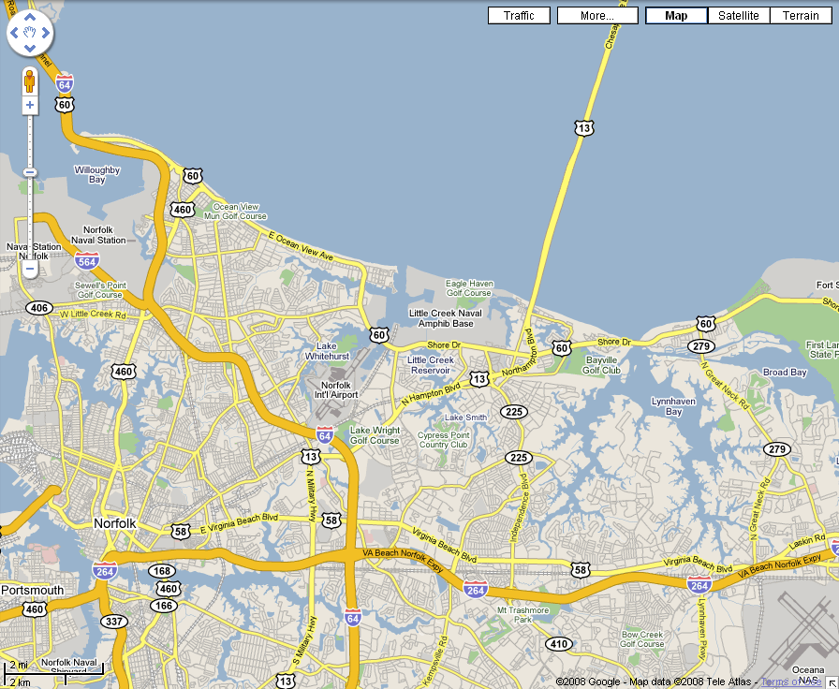
Norfolk International Airport
This is where you arrive.

Slide 6
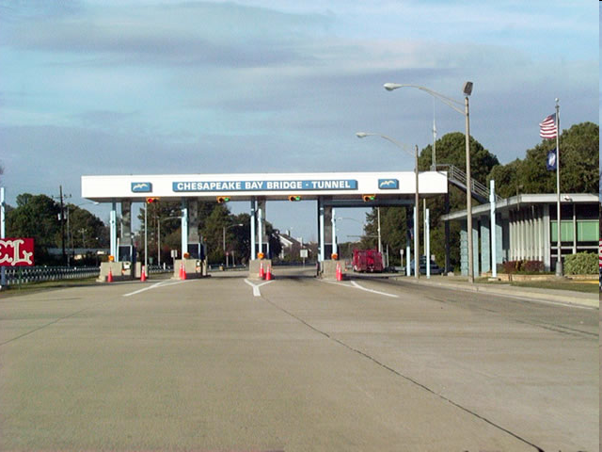
To get to the Eastern Shore, you must cross the Chesapeake Bay
by way of this bridge/tunnel.

Slide 7
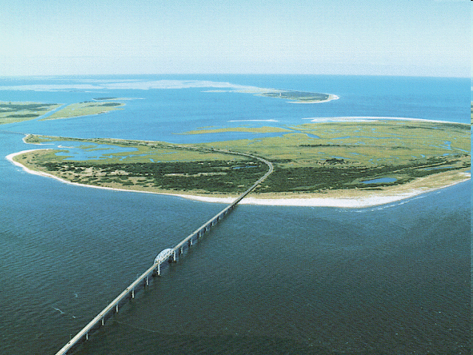
A view from the Chesapeake Bay Bridge-Tunnel,
crossing Fisherman’s Island, a National Wildlife
Refuge

Slide 8
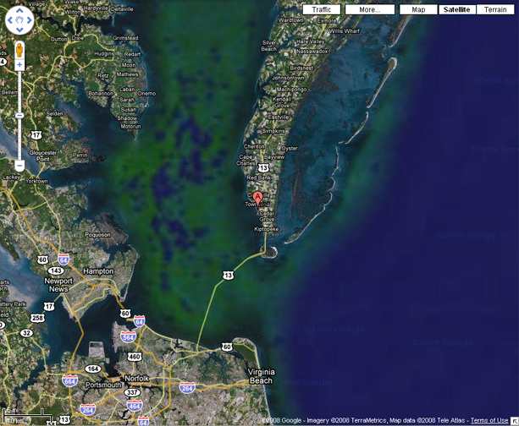
Our house is on the southern tip of the eastern
shore (on the western side)

Slide 9
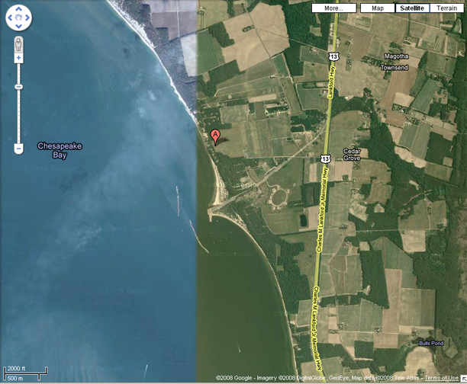
(Approximate color
of Chesapeake Bay)
(Approximate color
of rural vegetation)
After crossing the bridge, you are less than
10 minutes from the house.

Slide 10
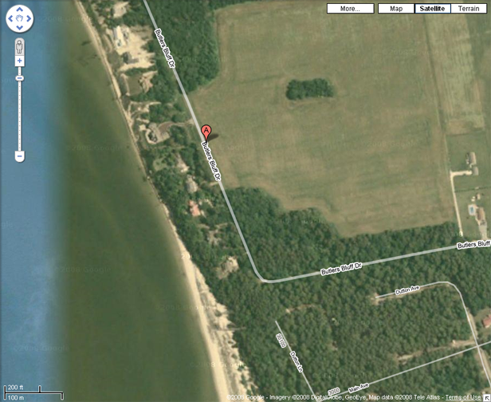
The house is on a beach. There is a farm
in the other direction.

Slide 11
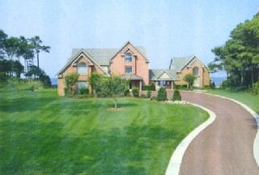
The House from the Front-
It has three parts- the Main House, the Apartment, and the Guest House.

Slide 12
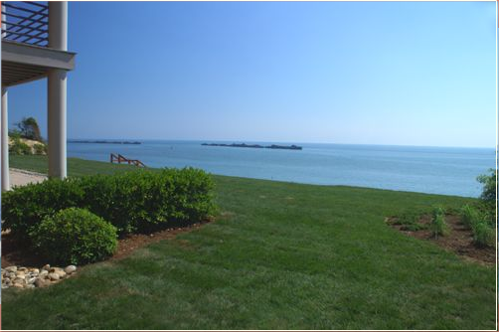
Turning in to the backyard…

Slide 13
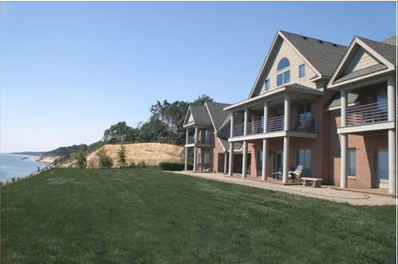
Back view of the house

Slide 14
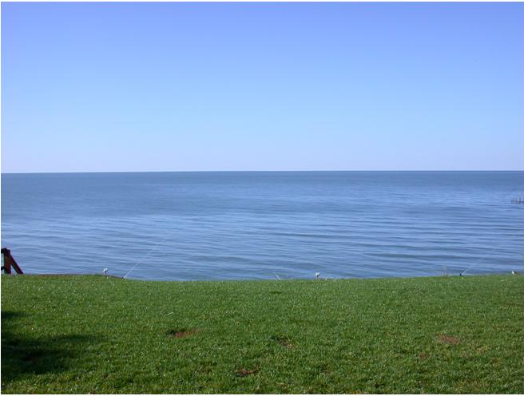
A View of the Chesapeake Bay from the Backyard

Slide 15
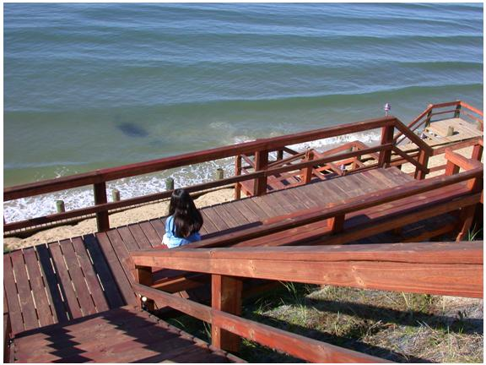
Steps Leading Down to the Private Beach

Slide 16
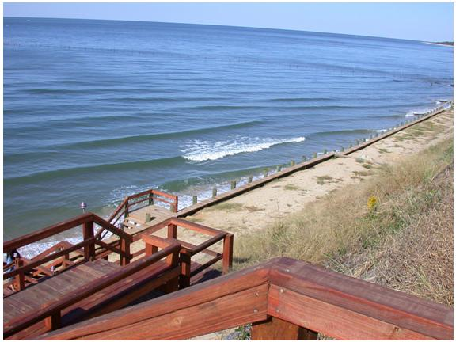
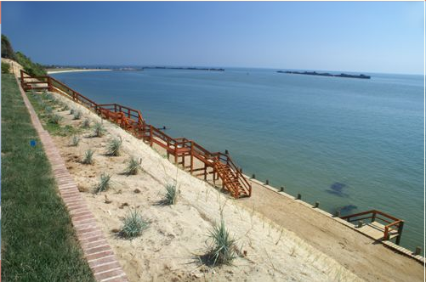
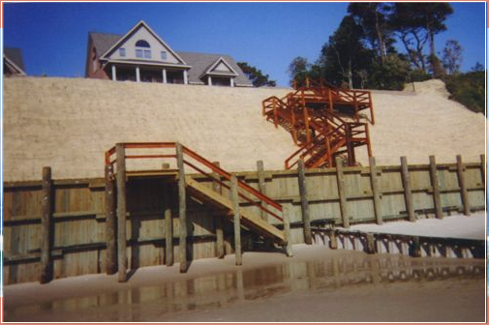
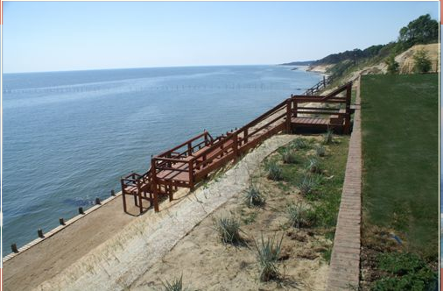
More Sights of the Beach

Slide 17
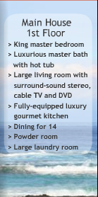
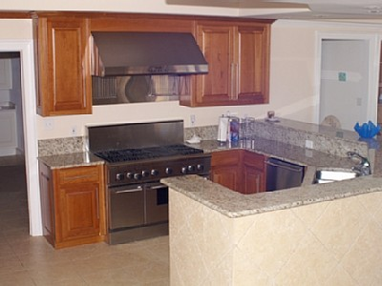
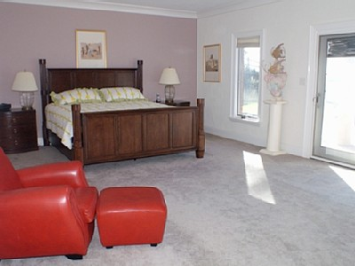
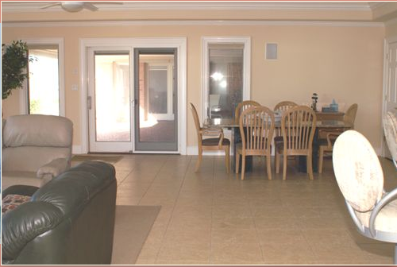
(possibly more)
Notes:
hi

Slide 18
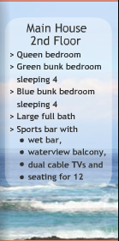
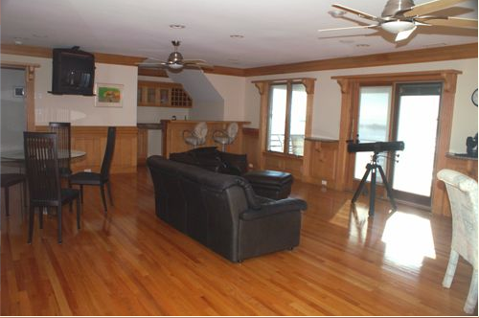
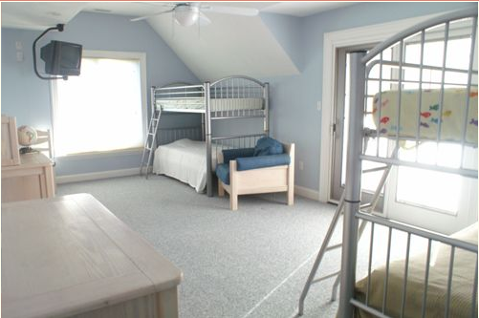

Slide 19
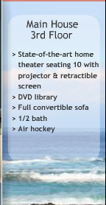
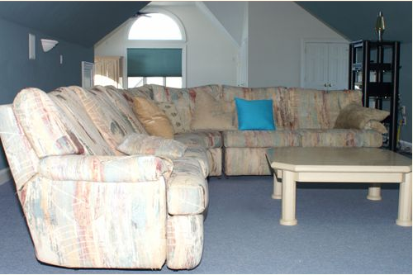

Slide 20
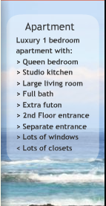
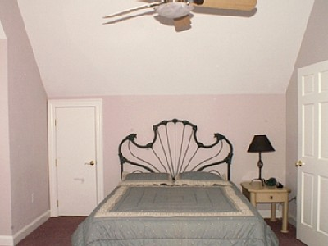

Slide 21
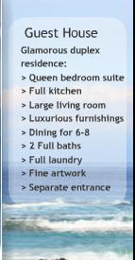
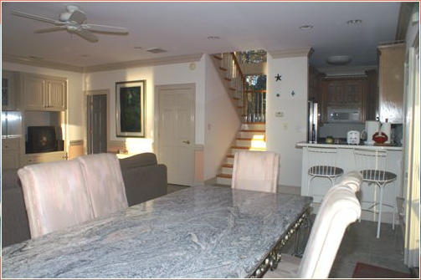

Slide 22
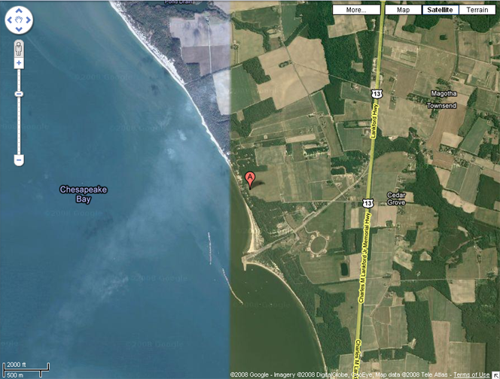
The house is nice, but what is there to do nearby?

Slide 23
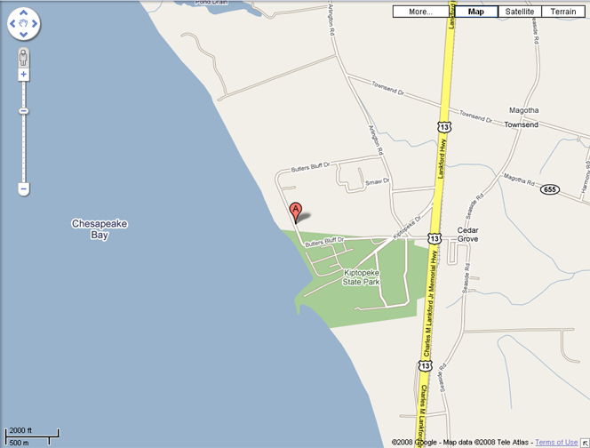
Walking for a few minutes gets you
to Kiptopeke State park

Slide 24
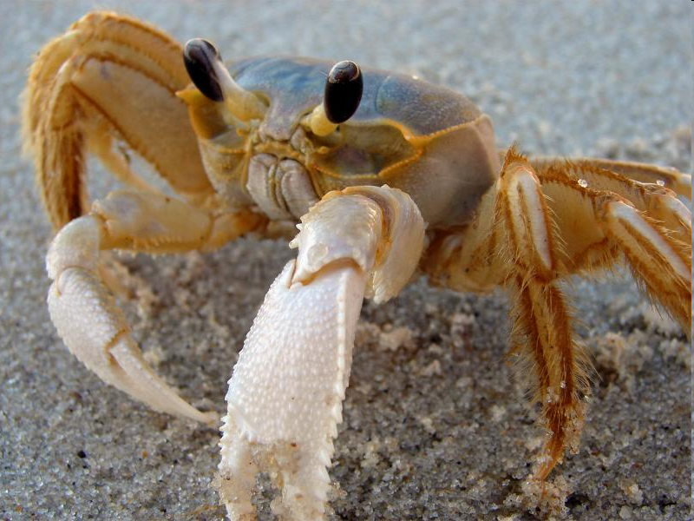
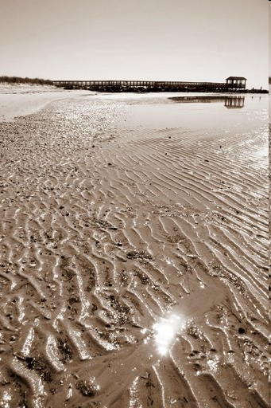
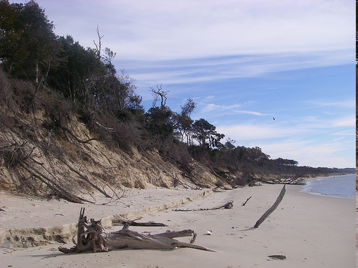
Kiptopeke State Park

Slide 25
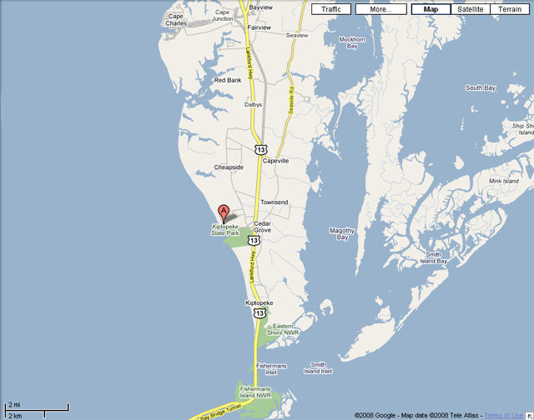
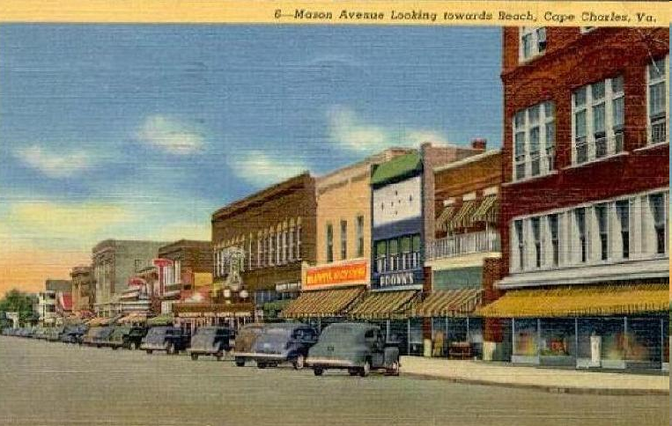
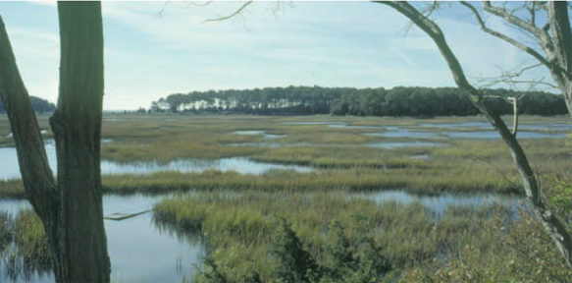
Other Nearby Sites of Interest
Historic Cape Charles
(and you wonder why the car
companies are going broke)
Eastern Shore
National Wildlife Refuge

Slide 26
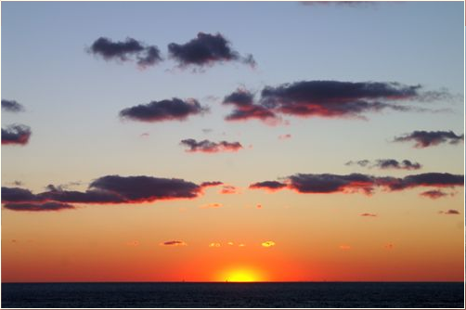
Until then…
Sunset on the Chesapeake

Slide 27
How to find out more
Bay Bluff (the house)
Information/Pictures: http://www.homeaway.com/vacation-rental/p181237
More pictures: http://www.castlemall.com/baybluff
Kiptopeke State Park
Official site: http://www.dcr.virginia.gov/state_parks/kip.shtml
Eastern Shore National Wildlife Reserve
Official site: http://www.fws.gov/northeast/easternshore/
Brochure: http://www.fws.gov/northeast/easternshore/PDF/Refuge%20Brochure.pdf

